Slide 1
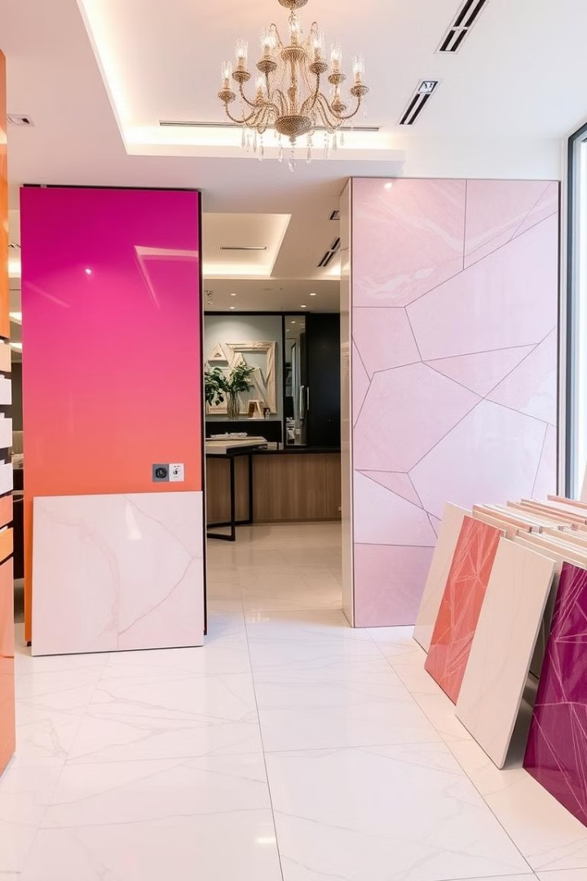


EG Company Overview
2023 Sales Trends and Patterns
by Ahmed Mahmoud

Slide 2
Content:
1. Setting the Stage: Our 2023 Sales Journey
Defining Our Goals
2. Laying the Groundwork: Data Acquisition
Sources of Data
3. Uncovering the Insights: Data Analysis
Exploratory Data Analysis (EDA)
4. Painting a Picture: Data Visualization
Visualizing Key Trends a Patterns
5. Sharing the Story: Interpreting and Communicating Results
Key Findings and Recommendations

Slide 3
EG specializes in manufacturing ceramic and porcelain raw materials.
This analysis : aims to provide insights into sales performance, overall value, customer analysis and materials.
Business Overview

Slide 4
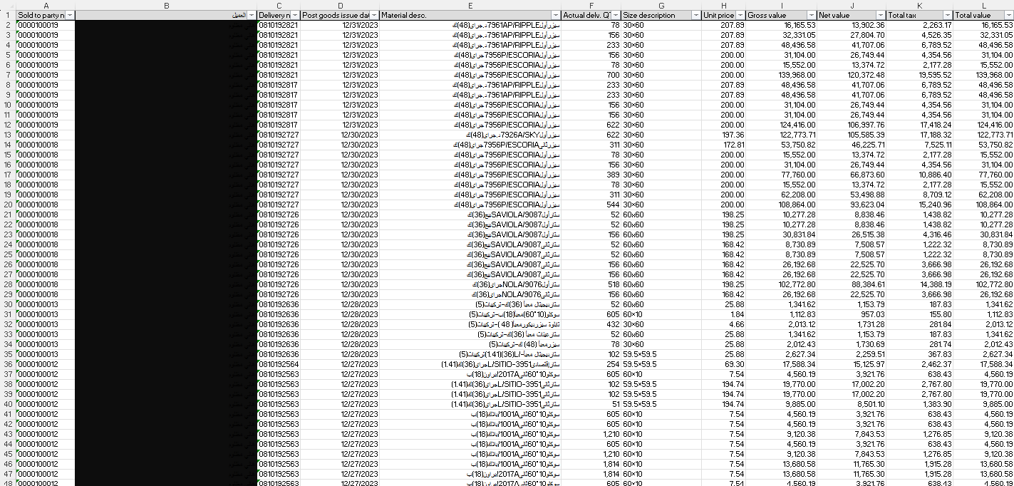
Dataset :

Slide 5
Column | Description
Sold to party no. | Unique customer numbers
Customer name | Names of customers
Post goods issue date | Dates of goods issuance
Material description | Description of items delivered
Actual delv. QTY | Quantity of each item delivered
Size description | Size of each item
Unit price | Price per unit
Gross value | Total value before deductions
Net value | Value after discounts
Total tax | Value after discounts
Tax amount for each transaction | Tax amount for each transaction

Slide 6
Total Sales and net Value
Total Sales
Total Tax
Net Value
353,528,254
49,493,955
304,034,298

Slide 7
Top Customers by Sales
Hani
Mohamed Al-Qattan
Ihab Abdel Aal
Total Value: 215,226,650
Total Value: 105,327,012
Total Value: 23,086,986
These top customers represent a significant portion of EG sales. Hani leads with the highest sales value, followed by Mohamed Al-Qattan and Ihab Abdel Aal Abdel Gayed Abd.

Slide 8
The top customers by number of orders closely mirror those by sales value. Hani leads with the highest number of orders
Top Customers by Orders
1
Hani
2
Mohamed Al-Qattan
3
Ihab Abdel Aal
Number of Orders: 6,530
Number of Orders: 3,709
Number of Orders: 910

Slide 9



Top Materials by Quantity Sold
Soclo 10*60 First 1001A/Black(18)B
Caesar Packed (48) K-Fittings(5)
Star Digital Packed-L/(36)(1.41)Fittings(5)
229 orders
190 orders
168 orders
These materials represent the top-selling products by quantity. The Soclo 10*60 First 1001A/Black (18)B leads in terms of numbers, indicating its popularity among customers.

Slide 10
Top Materials by Financial Return
Caesar First 7966/NOVELLA Gray(48)K
Value: 8,651,761
Star First 7966/NOVELLA Gray(36)K
These materials generate the highest financial returns for EG. The Caesar First 7966/NOVELLA Gray (48)K leads in terms of value, followed closely by its 36K variant and the Soclo 10*60 First 1001A/Black (18)B.
Value: 7,602,129
Soclo 10*60 First 1001A/Black(18)B
Value: 6,452,811

Slide 11
Quarterly Sales Analysis
1
Q1
Total Value: 70,286,585, Net Value: 60,446,463
2
Q2
Total Value: 95,190,037, Net Value: 81,863,431
The quarterly analysis shows a notable growth in the second quarter, followed by a slight decline in the fourth quarter. This trend provides insights into seasonal variations and market dynamics affecting EGMI's performance throughout the year .average=88,369,939
3
Q3
Total Value: 90,168,877, Net Value: 77,545,234
4
Q4
Total Value: 97,824,294, Net Value: 84,128,893

Slide 12
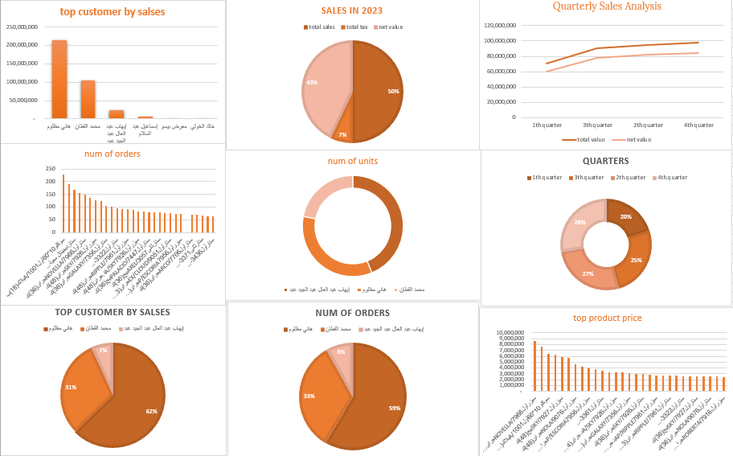

Slide 13




Sales Trends Analysis
The graph shows significant growth in Q2, with a slight decline in Q4. Overall, there's a positive trend in sales and value throughout the year.
Growth
Significant increase in Q2 sales
Trend
Positive overall trend throughout the year
Analysis
Slight decline observed in Q3

Slide 14

Recommendations and Conclusions
1
Focus on Top Customers
Develop strategies to maintain and grow relationships with top customers like Hani and Mohamed .
2
Product Mix Optimization
Analyze top-selling materials to optimize inventory and production.
3
Seasonal Strategy
Implement targeted marketing campaigns to boost Q1,3 sales.
These data-driven recommendations aim to enhance EG sales strategy, optimize product offerings, and address seasonal fluctuations. By focusing on top customers and products while addressing market trends, EGMI can further strengthen its market position.

Slide 15
?
Thanks
Do you have any question

